Slide 1







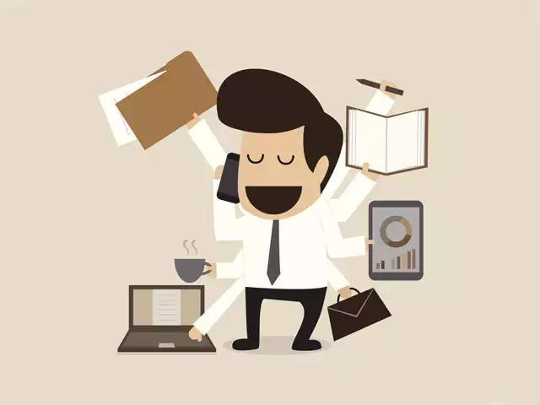


Growth
of
Self-employment
Presented By PinPin

Slide 2







Objectives
Problem Statement
Data Analysis
Pitch & Conclusion

Slide 3





Background
Quote
With all the chaos in the world, from recent pandemic to the life changing technology, it caused a sudden rise in Self-Employment Rates.
However, it keeps fluctuating!
“The share of self-employed in the resident workforce rose in June 2020 to 14.7%, from 13.5% in June 2019.”
- Quoted from an Article from the Ministry of Manpower.

Slide 4



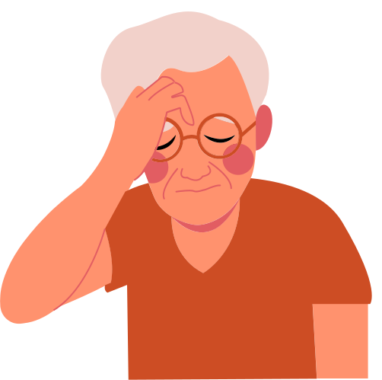



Mr Lee’s Mission
Mr Lee is in Ministry of Manpower and is given the task of stabilizing the self-employment rates as it benefits the government.
Find out the cause of this fluctuation in Self-Employment Rates
Pitch a solution after the research to stabilize the Rate

Slide 5




Analysis question
What caused the sudden Rise & Fluctuation in Self-Employment?
How to stop the fluctuations it?

Slide 6

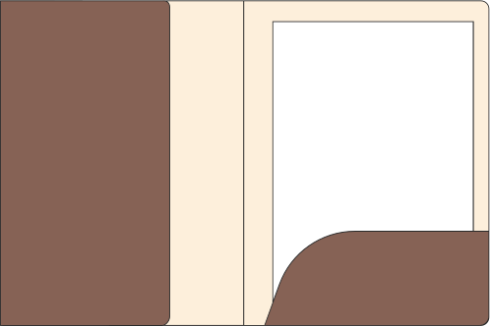





Our
Dataset
Percentage Self-Employed
Wellbeing SurVey
Motivations for Physical Activity

Slide 7

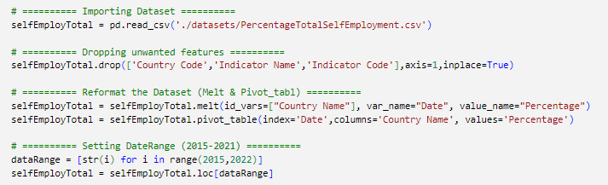
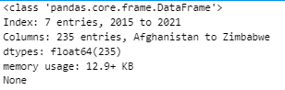

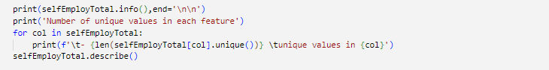
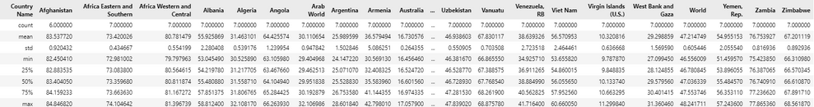
Self-employment rate
CODE
Visualize
Data Processing
DataFrame
Date Range - 2015-2021
234 Countries + World
Displaying

Slide 8
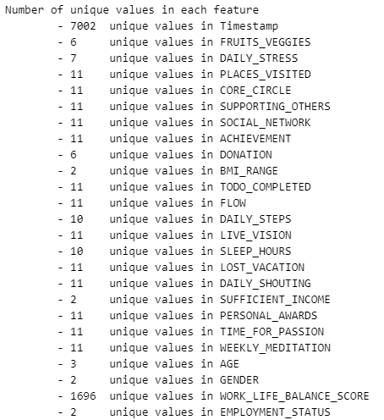
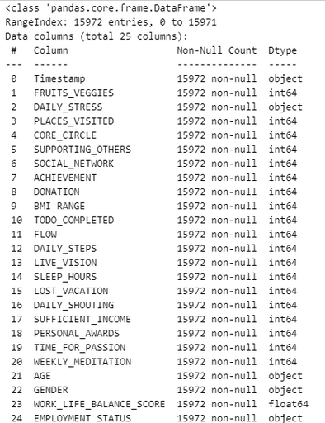
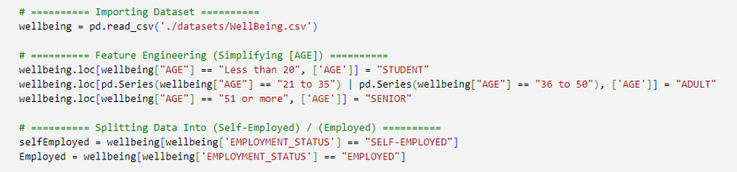
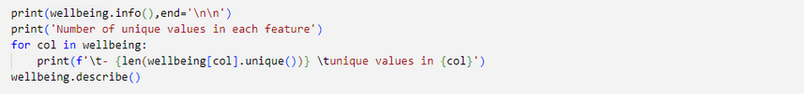
WellBeing Survey
CODE
Visualize
Data Processing
Displaying

Slide 9
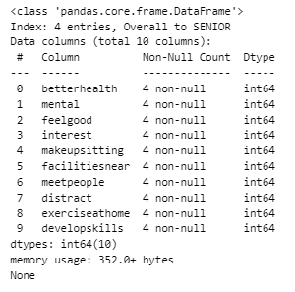
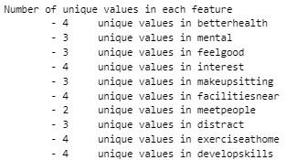
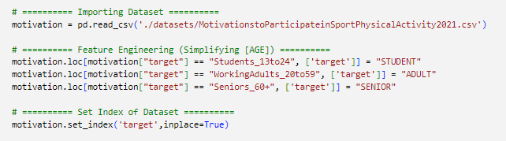
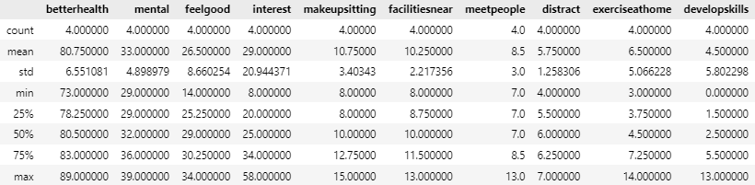
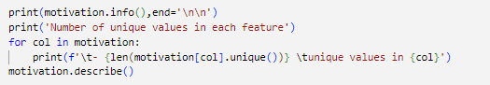
Motivation
CODE
Visualize
Data Processing
Displaying

Slide 10


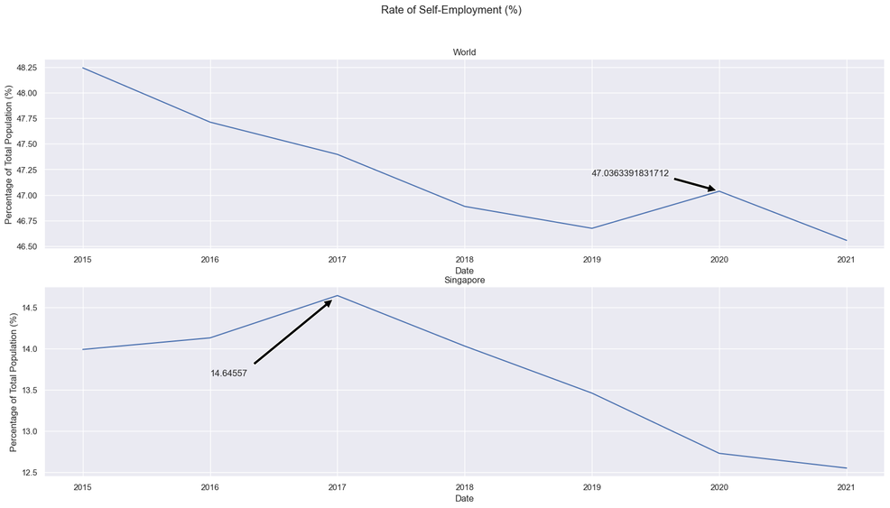

Line Graph
Line Graph:
Track Self-Employment Rates over Time
In General
World
Decrease, but suddenly increased at 2020
Could be Due to the recent pandemic (COVID-19)
Singapore
Rose from 2015-2017, but dropped since
MySkillsFuture started at 2015
Sources:
MySkillFuture
COVID-19

Slide 11
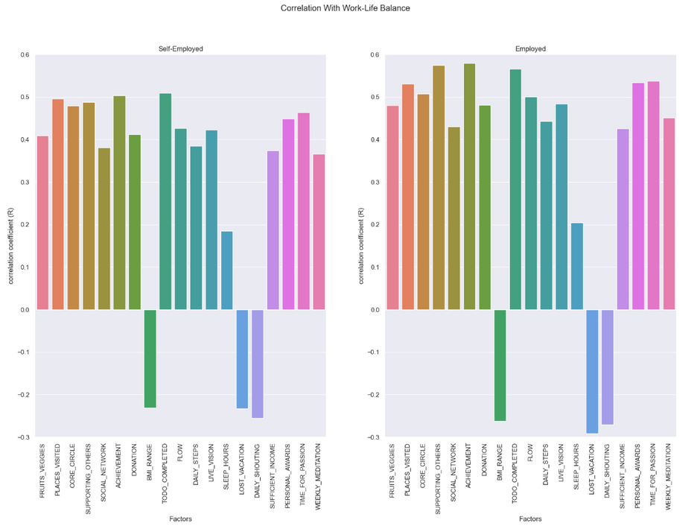
Bar Graph
Bar Graph:
Compare Correlation of multiple features
In General
Self-Employed
TODO COMPLETED has the highest relationship with WORK_LIFE_BALANCE_SCORE
Employed
ACHIEVEMENT has the highest relationship with WORK_LIFE_BALANCE_SCORE

Slide 12
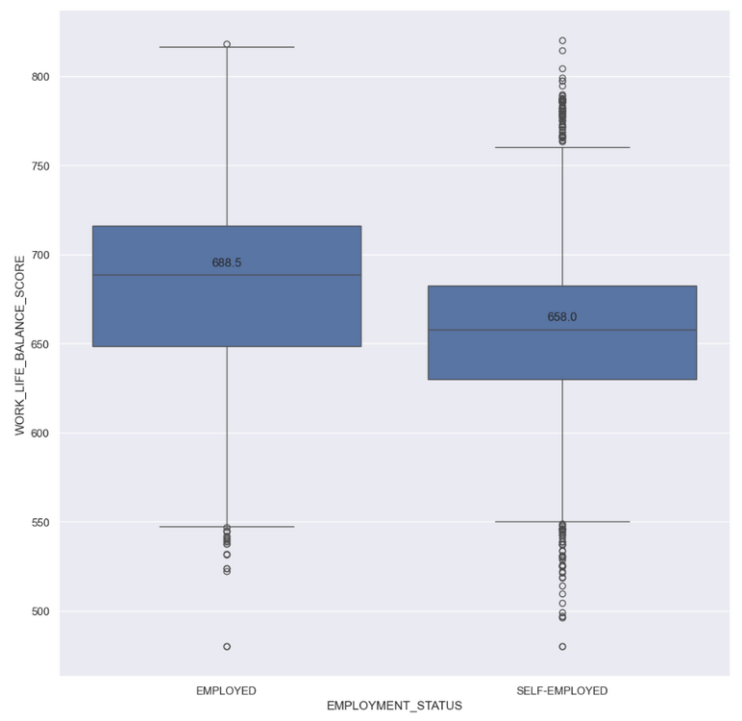
Boxplot
Boxplot:
Compare Distribution Employed Status
In General
Self-Employed
More Outliers
Mean is Less than Employed
Employed
Less Outliers
Generally Better Score then Self-Employed
Reasons:
DO before THINK habit.
This would lead to rash decisions where they become self-employed but its not for them.
NEW Trend
people are still figuring how to manage. Thats why theres so many outliers as everyone is different

Slide 13
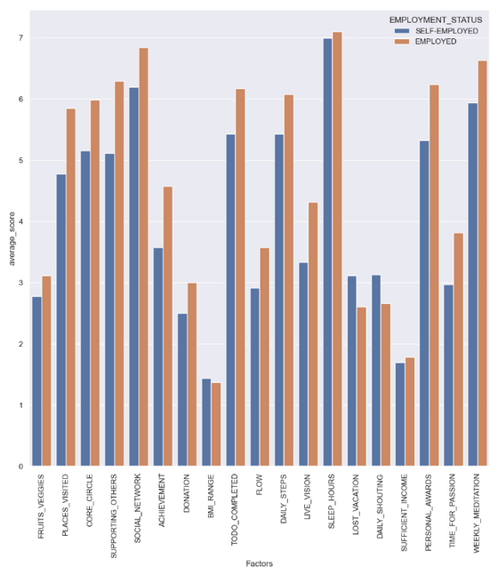
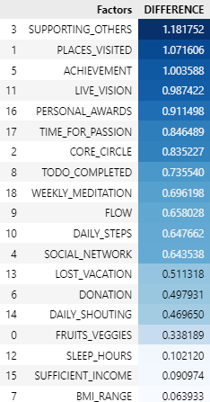
Bar Chart
Boxplot:
Compare Average Responses with Employment Status
In General
Highest Difference
SUPPORTING_OTHERS
PLACES_VISITED
ACHIEVEMENT
Reasons:
Supporting Others (Employed^)
Employed has to work in a team. Which enhances their ability to support others.
Places Visited (Employed^)
Company Gives Vacation Leave. While self-employed has to invest it back to their company
Achievement (Employed^)
With the competitiveness of the current industries, it is harder for self-employed to achieve more than companies

Slide 14


First Conclusion
Rise in Self-Employment:
Causes
Covid-19
MySkillsFuture
Fluctuations
Rash Decision
Not Prepared

Slide 15
🔍Research🔍
Engaging in regular physical activity, such as taking more steps throughout the day, has been consistently linked to improved work life wellbeing.
Question:
Does Daily Steps really increase your work life wellbeing?

Slide 16
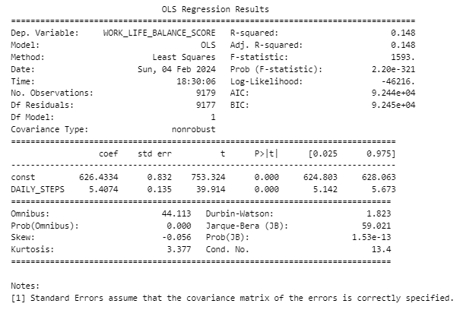
OLS
Ordinary Least Squares:
Regression with Daily Steps with Work Life Balance
In General
R-squared & Adj. R-squared (0.148)
Many Outliers (Not a good fit)
Regression formula
Score = 5.4074(Daily Steps) + 626.4334
Coef of Daily Steps
Coef is positive (5.4074 > 0)
This means theres an Increasing Relationship with WORK_LIFE_BALANCE_SCORE
More Steps = Better Score
F-statistic & P-Value
Significant Model
High F-statistic (1593)
Low P-Value (2.20e-321)
Number of Trials (9179)
Method: Least Squares

Slide 17
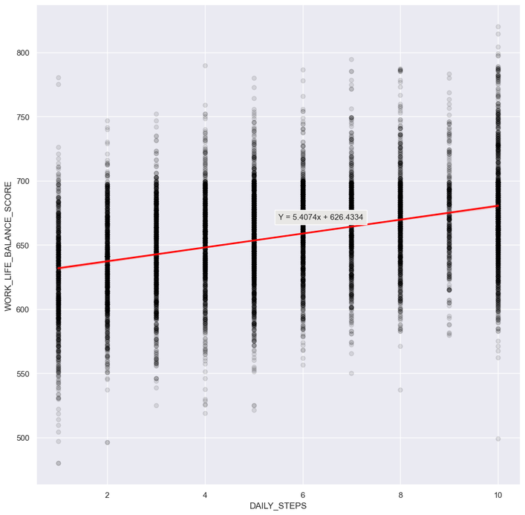
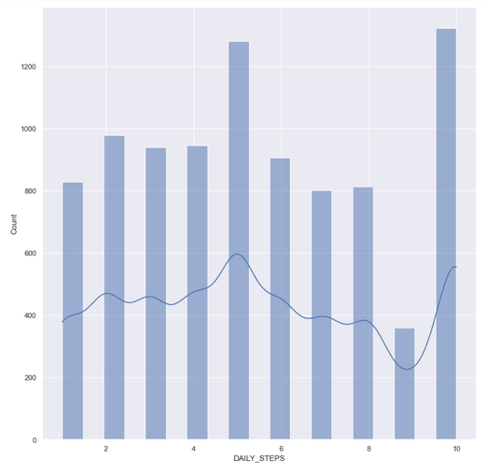
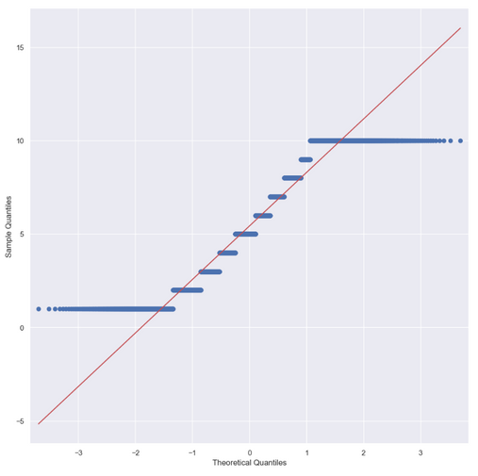
Regression
Validate
Quantile-Quantile Plot
Histogram
2 Peaks (Center | End)
Uniformed Distribution
Increasing Relationship with work life balance score
More Steps = Better Score

Slide 18
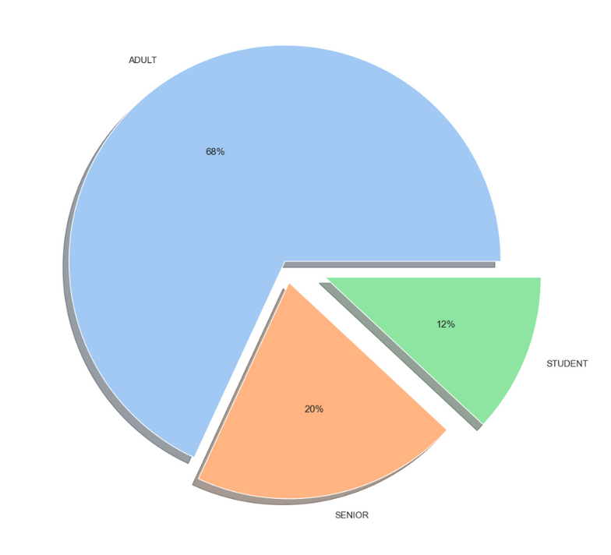
Pie Chart
Pie Chart:
Percentage Distribution of Self-Employed Workers
In General
Adults has the highest percentage
Students have the lowest percentage
Reasons:
Adults make up most of the population of the working force. It would only make sense that there is a higher percentage of adults that seniors or students.
There still are Students as now with the growing technology, the younger generation has enough to get started on their own business.

Slide 19
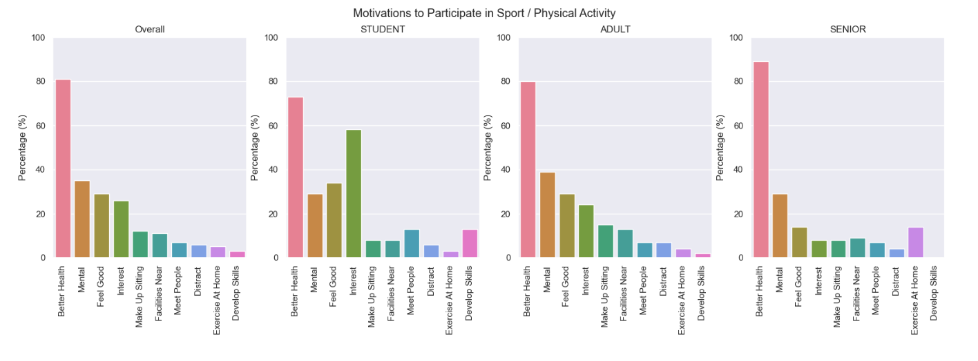
🏋🏽‍♂️Motivation🏋🏽‍♀️

Slide 20
Second
conclusion
Ways to Stop Fluctuations:
Increase Work Life Balance Score of Self-Employed
How?:
^Daily Steps
Host Fitness Challenge
Public Health Campaigns
Discounts on healthier food

Slide 21




thank You

